Slide 1

SAFE CHILDBIRTH & PATIENT SAFETY
DR VINEETA
ASSOCIATE PROFESSOR
DEPARTMENT OF OBSTETRICS & GYNECOLOGY
AIIMS DEOGHAR

Slide 2

ALARMING FIGURES
Maternal mortality rates have reduced by 34% worldwide from year 2000 to 2020
In year 2020 800 maternal deaths per day preventable causes
1 death every
2 minute
95% of all maternal deaths occurs in lower and lower middle-income countries (87% in sub-Saharan and southern Asia)
Source: World Health Organization, 2024

Slide 3
LIFETIME RISK OF MATERNAL MORTALITY IN HIGH INCOME COUNTRY IS 1 IN 5300
LIFETIME RISK IN LOW INCOME COUNTRIES IS 1 IN 49

Slide 4
FACTORS RESPONSIBLE
Service care
Poor quality care, lack of trained staffs, shortage of medical supplies, poor accountability of health systems
Social
Social determinants like inequality in access to education, income, race and ethnicity
Harmful gender norms with low prioritization of women’s health
Other
External factors like instability or humanitarian crises

Slide 5
THE KNOW-DO GAP
POOR QUALITY IS BIGGER KILLER THAN INSUFFICIENT ACCESS TO CARE
3.6 MILLION DEATHS DUE TO INSUFFICIENT ACCESS TO CARE
Sources: Health Affairs, 2012 September;31(9):2114-2122. Kruk ME et al, The Lancet, 2018 September;

Slide 6
Under NHM Government Commitment To Provide Quality Care During Childbirth
JSY-To increase institutional delivery
JSSK-Reduce out of pocket expenditure
Establishment of delivery points: 24*7 PHCs, FRUs, MCH training, Obs HDU/ICU, Referral transport
SBA training-Dakshata, Daksh, Bemoc, RTI/STI trainings
PMSMA-Detect high risk pregnancy
Laqshya-Respectful maternity care
Maternal death surveillance
SUMAN-Assurance of service provision
Midwifery Initiative-Promote physiological birthing

Slide 7
WHO CHECKLIST FOR SAFE CHILDBIRTH
Checklist is a tool to organize complex process >>essential to deliver better and safer care.
FOUR PAUSES
AT ADMISSION
Recognise and treat complications
Need for referral
Prepare for delivery
Educate for danger signs
BEFORE PUSHING/
CAESEREAN
BEFORE PUSHING/CS
Detects and treat complications
Prepare for routine events
Prepare for possible crisis situation
SOON AFTER BIRTH WITHIN AN HOUR
Detect and treat complications
Educate mother and companion of danger signs
BEFORE DISCHARGE
Arrange follow up
Family planning options
Education of danger signs (ongoing care)

Slide 8
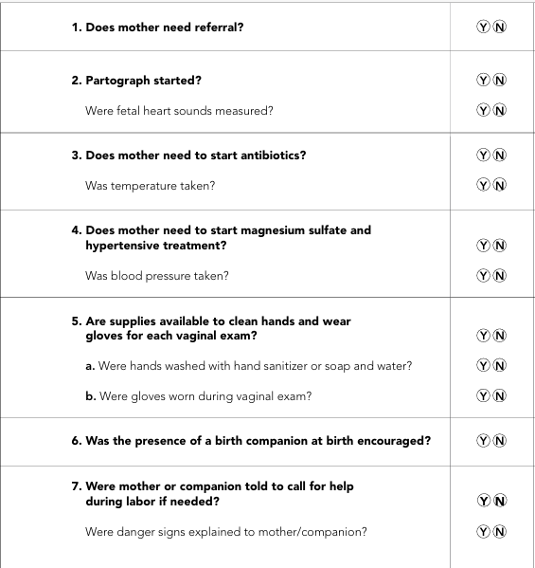
AT ADMISSION

Slide 9
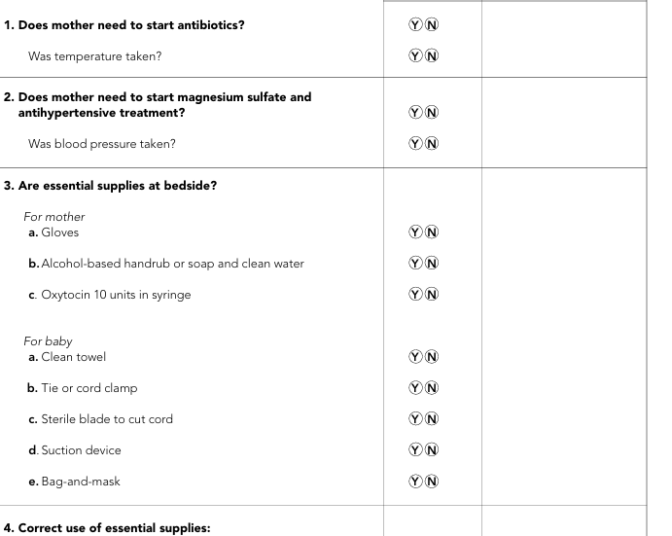
JUST BEFORE PUSHING/ CS

Slide 10
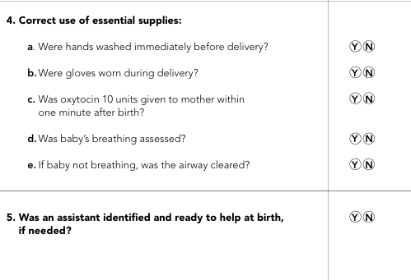
JUST BEFORE PUSHING/ CS

Slide 11
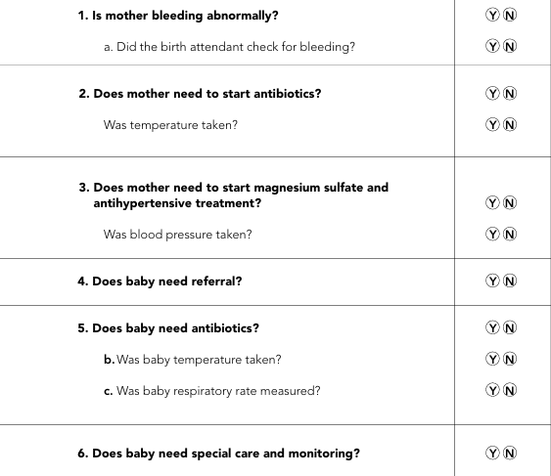
SOON AFTER BIRTH (WITHIN ONE HOUR)

Slide 12
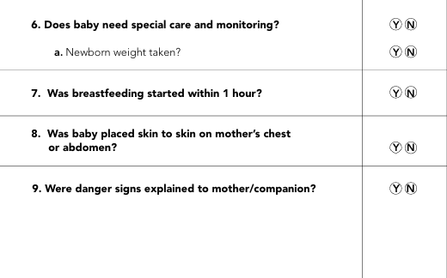
SOON AFTER BIRTH (WITHIN ONE HOUR)

Slide 13
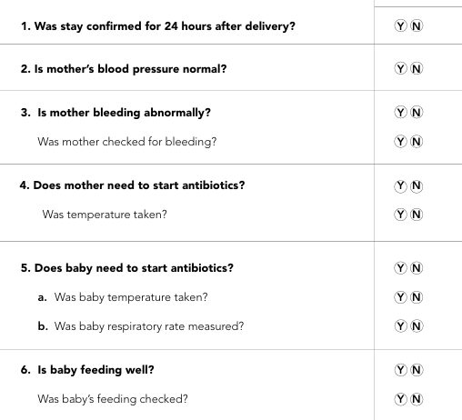
BEFORE DISCHARGE

Slide 14
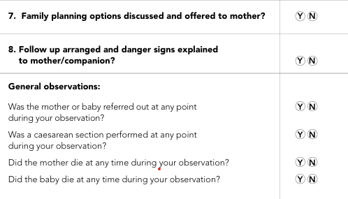
BEFORE DISCHARGE

Slide 15
KEY STRATEGIES FOR SAFE CHILDBIRTH
Delivery by trained skilled birth attendant (Dakshata and Daksh training)
Referral of high-risk women to higher centre
Labor room procedure are standardized and ensure all logistics and drugs availability
Partograph to be maintained and active management of third stage of labor
Initiate early and on demand breastfeeding
Emergency neonatal resuscitation and referral to higher centre
Counselling and provision of family planning
PNC visits on 3rd, 7th,14th, 21st,28th and 42nd day

Slide 16
Structured pathway to begin the Quality journey in healthcare
Continual training
Robust implementation
Periodic audits

Slide 17


